Slide 1
Sample Code Guide - Protect and Wrap with Hot Folder
How to run the Sample Java Code using Enterprise Policy Server

Slide 2
SAMPLE CODE Summary and Purpose
This Sample Code will help you understand the protection and html wrapping flow using Seclore Java SDK
The protection type used in this sample code will allow you to protect a file using a predefined Policy. This protection type is known as Protect with Hot Folder (HF).
You are expected to know the basic concepts of Seclore such as
  Policy Server
  Enterprise Application (EA)
  Hot Folder (HF)
  Policy
  Lite Online Editor
  File Owner
  IRM Permissions
  Seclore Agent
  HTML Wrapping

Slide 3
Sample Code Package
To start with the Sample Code, unzip the delivered package. Package will contain the following and this slide deck.
  Sample Code
  Java SDK
  Code walkthrough video
This slide deck contains steps to run the Sample Code

Slide 4
LIST OF Content
Seclore Concepts and Component Details
Prerequisites
Running the Sample Code
Verify Sample Code Output
Code Blocks

Slide 5
Seclore Concepts & Component Details

Slide 6

Seclore components

Slide 7
Primary Components
Policy Server
  Central repository of all access keys, usage rights and file activity details.
  Central repository of all user activity / audit logs.
  Computes and serves effective rights for users.
  Standard J2EE application.
  Runs on Windows Server.
  Communicates to Desktop Agent/Mobile App/Web Services using HTTPS connection.
  Encrypts critical info on top of HTTPS to avoid man-in-the-middle attacks.
Seclore Agents
  Available for Windows, Mac, iOS, Android and online file access.
  Required for opening protected files.
  Communicate to Policy Server in the background.
  Control and track all user activities.
  Support all major versions of respective Operating Systems.

Slide 8
Primary Components
Database
  Stores encryption keys, user permissions and user activity details etc.
  MSSQL and Oracle are supported.
  Can run on any Operating System.
  Repository Adaptor (Standard / Custom Authentication)
  Connects to User Repository / User database.
  Manages user authentication.
  Searching of Users / Groups / User-Group mapping.
  Intelligent in-memory caching in Policy Server to ensure minimal load on existing infrastructure.
  Single Sign-on (domain authentication) is used if user is already logged in to the domain.
  Available Out-of-the-box for Active Directory, IBM Tivoli and Seclore Identity Manager
  Can be custom built for other repositories
Lite Online Server
  Comprises of Lite Online Viewer and Lite Online Editor
  Agentless access to protected files
  Documents rendered with watermark
  Runs on windows server
  Lite Online Editor provides editing capabilities for Office documents
  Protected file is uploaded to the Lite Online server through the Policy Server

Slide 9
Server SDK
​ | .NET​ | JAVA​
Build Platform​ | .NET Framework 3.5​ | JDK 8​
Platform Support​ | Integrating application to be .NET 3.5 & above​ | Integrating application to be JDK 8 & above​
OS Support​ | Windows​ | Windows, Linux​
Compliance​ | Uses FIPS compliant Algorithm​ | Uses FIPS compliant Algorithm​

Slide 10
Seclore Concepts
Enterprise Application
  Enterprise Application (EA) is the construct on Seclore Policy Server created to facilitate integration with Applications. An EA was a way for an Application to connect to Seclore through Seclore APIs. Each EA created has a Unique ID and can be mapped to one integrating application. Seclore APIs are initialized by referring to the Seclore Policy Server URL and the EA
  The integrating application will use the EA ID and Passphrase (configured at the time of EA creation) for authenticating the Seclore API with Policy Server. This authenticated session will be used by the Seclore API to perform any subsequent actions like protect, upload file to Lite Online etc.
  The EA instance also allows you to configure a web service URL which is used by the Policy Server during Policy Federation.
Hot Folder
  HotFolder is a construct available within an EA. It is a combination of a Default File Owner, a default Classification on the protected files.
  Each HotFolder has a Unique ID and One EA can have one or more Hot Folders. Based on a Business logic requirement, a HotFolder may be mapped to the Integrating Application’s Document Library/Director or even a Project.
  At the time of Protection, the Seclore API expects a HotFolder ID to be passed as a parameter.

Slide 11
Prerequisites

Slide 12
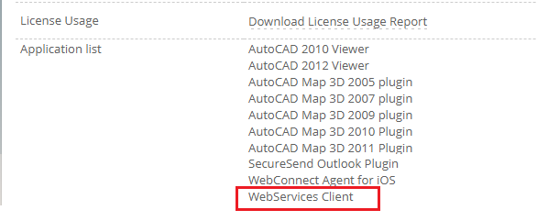

Servers and API license
Policy Server and Lite Online Editor
  Identify the PolicyServer(PS) deployed/used by your organization on which this exercise is to be carried out.
    Check with your IT security team or contact your Seclore Point of Contact for this
  This is usually done on a UAT/Test PS , but can also be done in the production PS
  Check if the Seclore Policy Server is accessible. Note the URL.
API License
  Your organization will require an API license to use Seclore APIs for Integration.
  You can check this yourself if you have access to the Policy Server as root/sysadmin user. Below are the steps to follow to check this out
    As Root/Sysadmin:
    Login to PS using the sysadmin URL
    Click on ‘License’ tab
    Check if ‘WebServices Client’
    exists under Application List

Slide 13
Users and Protector license
Users in the PS
  The Policy Server will be integrated to a user repository and all users will be logging in using a username/password of that repository. It is usually Active Directory , or any other LDAP system. It can also be a custom repository.
  You will need following users for this sample application
    End user/Recipient – This is a user who will be opening the file once it is protected. Please identify an end user.
    File Owner – This is a user who will be protecting the file and will be the file owner. This user should have a Seclore Protector License
Protector License:
  Enable Auto Assign License in the Repository Adaptor Configuration to automatically assign license to a user.

Slide 14
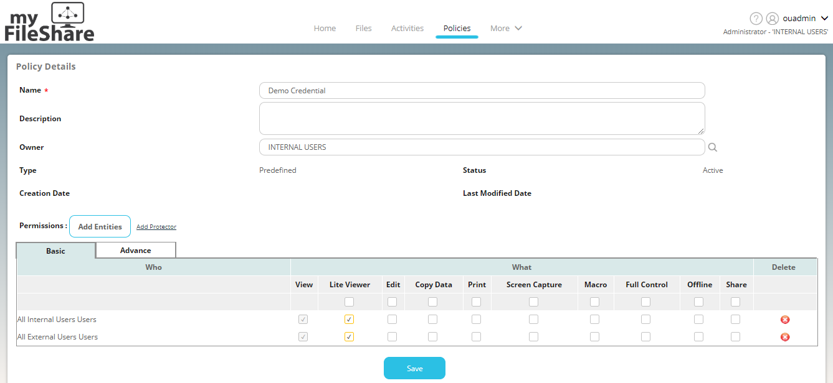
Policy
OU Admin should follow the below steps
Login as OU Admin
Change context to OU Admin
Click on Policies Tab
Click on Create Policy
Enter Policy Name
Select Policy Owner.
Click on Add Entities and add users to whom you want to give permission to a protected file.
Save Policy

Slide 15
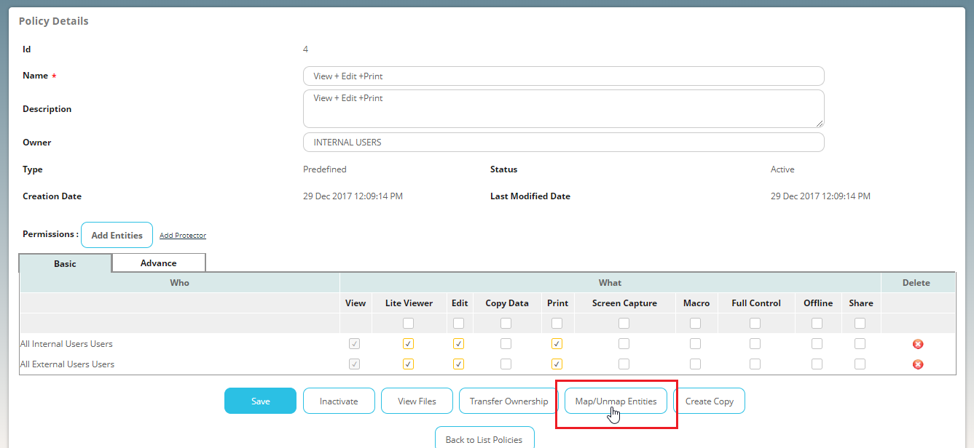
Policy Continued
OU Admin should follow the below steps
Login as OU Admin
Change context to OU Admin
Click on Policies tab
Search the Policy which you created in the last step
Click on Map/Unmap Entities
Click on Add Entities
Add users whom you want to be able to use the Policy.

Slide 16
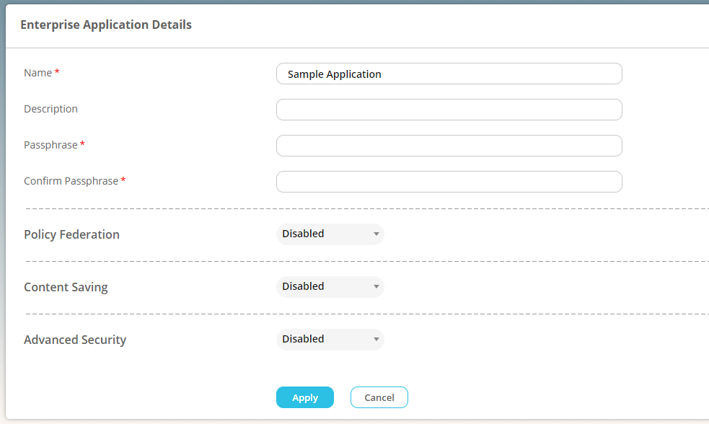
Enterprise Application
Policy Server Root/Admin user should follow the below steps
Login as sysadmin
Click on App Integration Tab
Click on Add Enterprise Application
Enter all mandatory details.
Note down the Passphrase – this will be configured in the config.xml file
Go back to the list of Enterprise Applications page and verify the Enterprise Application.

Slide 17
HOT FOLDER
Policy Server Root/Admin user should follow the below steps
Login as sysadmin
Click on App Integration Tab
Locate the Enterprise Application which you had created in the previous step.
Click on the “Manage Enterprise App” icon as shown in the image below.
Click Create Hot Folder
Enter below details on the Create Hot Folder page
Owner – Select the user whom you had assigned protector license
Name – Give a name to the Hot Folder
Classification – Select a classification
Credential – Search the Predefined Policy which you had created and move it to “Selected Policies” section
Click on Add
Refer screenshot in next slide.

Slide 18
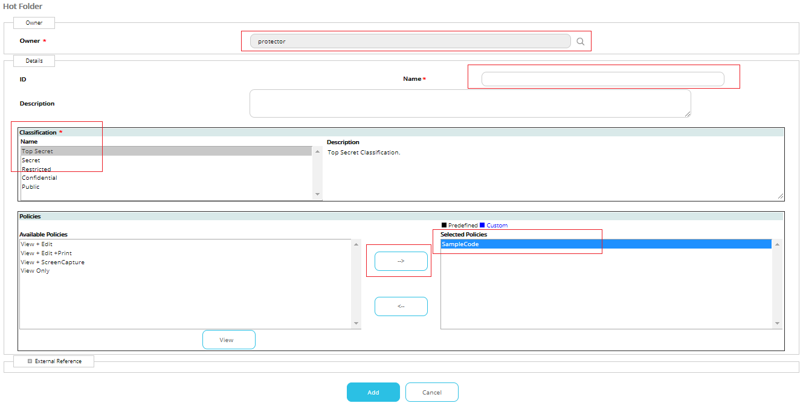
Creating Hot Folder

Slide 19
Seclore Agent
To open the protected file, you need to have Seclore Agent installed on your machine.
Contact your Seclore contact to get the Seclore Agent.

Slide 20
Java Cryptographic Encryption Files (applicable For JAVA 8 and ABOVE)
Seclore uses strong encryption that is not supported by default Java package so you will need to replace the JCE files (depending on your version of Java) that support unlimited strength.
The unlimited strength JCE files are available in the package shared with you in the following folder:
  \Sample Code\Docs\JCE Files
The folder will have two jars, local_policy.jar and US_export_policy.jar
Place it in the <JRE_FOLDER>/lib/security/ directory of the machine where will be running the Sample Code.
Take backup of old JARs before replacing.

Slide 21


Replace in <JRE_FOLDER>/lib/security
1
JRE/Lib/Security
2
JDK/JRE/Lib/Security

Slide 22
SSL Certificate
If Policy Server is running on self signed certificate, need to import the certificate into JRE which is used for Client Library.
Steps to import the self signed certificate:-
  Access Policy Server in any browser and download the self signed certificate.
  Execute below command from CMD
  <JRE-FOLDER>\bin\keytool.exe -import -alias "<ALIAS-NAME-FOR-CERTIFICATE>" -keystore "<JRE-FOLDER>\lib\security\cacerts" -file "<Downloaded_CERTIFICATE-PATH>“
  Example : keytool -import -alias "ps_cert" -keystore "C:\Program Files\Java\jre7\lib\security\cacerts" -file “XXXXX\filesecure.cer“
If it asks for password, enter 'changeit' , this is default password for jre.

Slide 23
Running the Sample Code

Slide 24


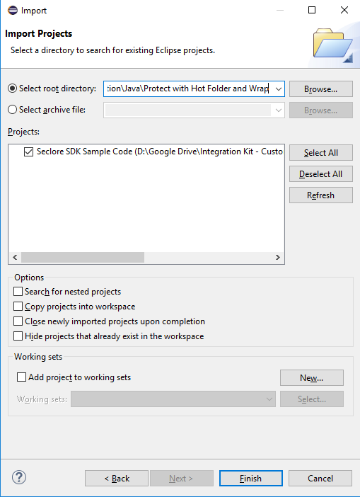
Import the project into an existing workspace in Eclipse
Import the ‘Protect and Wrap with HF’ project into an existing workspace in Eclipse

Slide 25
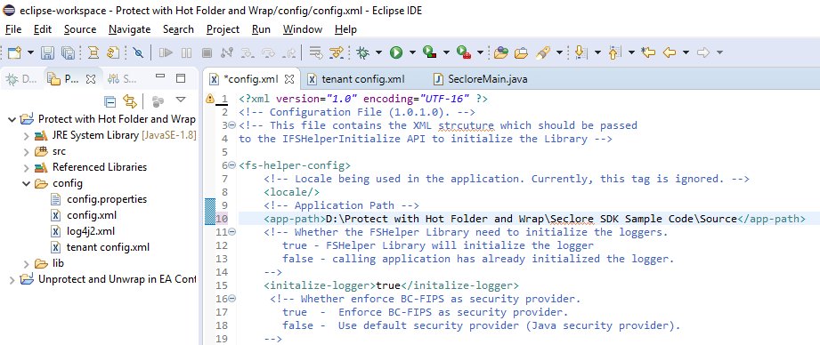
Configuration: config.xml
Configure the ‘config.xml ‘ as explained below:
<app-path> : Provide path of the Source folder.
<initialize-logger> : Set to true

Slide 26
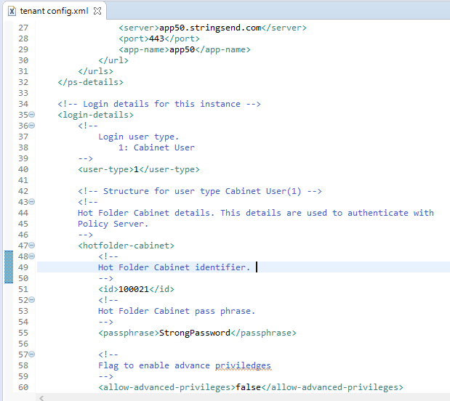
Configuration : tenant config.xml
Configure the ‘tenant config.xml ‘ as explained below
Enter details of the Seclore Policy Server:
<server>: Policy Server
<port>: Port
<app-name>: Application name
Example: If your Policy Server URL is https://app50.stringsend.com/app50
the configuration will look like the config shown in the screenshot
Enter login details:
<user-type> : Set to 1
<id>: Enterprise Application ID that you created in Policy server
<passphrase> : Enterprise Application Passphrase

Slide 27
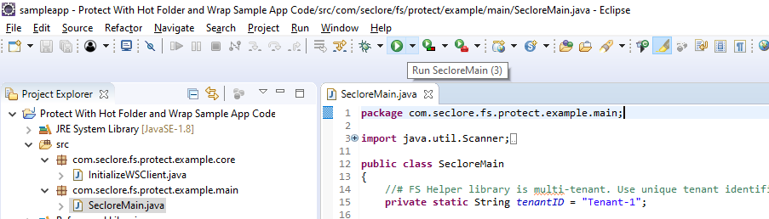
Executing Sample Code
Execute the sample code

Slide 28
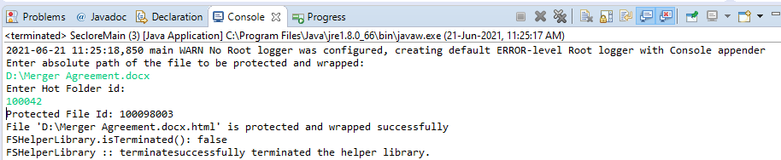
Executing Sample Code – Protection + HTML Wrap
Execute the sample code : Console Output
Enter the absolute path of the file you want to protect.
Enter HF ID which you had created in the Enterprise Application
On successful protection and wrap the sample code will display the Protected File ID.
The source file gets protected and HTML wrapped.

Slide 29
Verify Sample Code Output

Slide 30
Verify File is Protected and Wrapped
HTML Wrapped file will have an “.html” extension added to the source file.
If you protect and wrap a docx file for example “Test Protection.docx”, the output file will be changed to “Test protection.docx.html” in the same location.

Slide 31
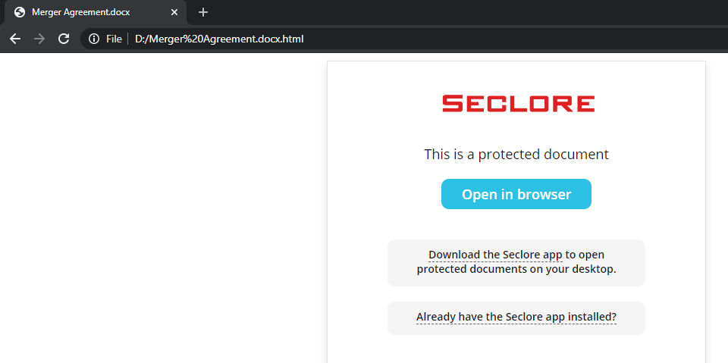
Viewing the Protected and Wrapped File – Without Agent
Open the HTML Wrapped File without installing the agent.
File will be launched in the browser.
Click ‘Open it now!’ to view the file in the Seclore Online Editor.
Login using authorized username and password.

Slide 32
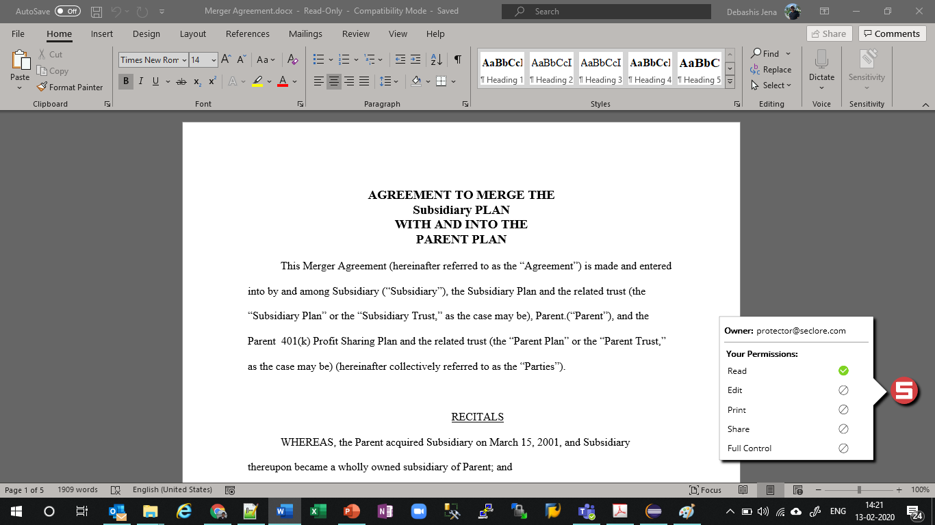
Viewing the Protected and Wrapped File – With Agent
Install the Seclore Agent
Open the protected file.
File will open for authorized users based on user permission defined in the policy server.
Login using authorized username and password.
Protected File Opens

Slide 33
Code Blocks

Slide 34
Protect and Wrap Approach
Initialize FS Helper Library using initialize() and initializeHelper()
  Include all supporting DLLs or Jars
  Configure the Logger
  Configure the Seclore Policy Server details
Get inputs for File Protection
  HotFolder ID
Check if the file is already Protected and wrapped using isProtected() and isHTMLWrapped()
Check if the file is supported for protection (advanced and universal) and wrapping using isSupportedFile(), isBasicProtectionSupported() and isHTMLWrapSupported()
Create the protectXML -- which will be an input to the protectAndWrap() method
Protect the file with sdk’s protectAndWrap() method, by passing all the required parameters, including protectXML. Successful Protection returns the protected file path
terminate() the library

Slide 35
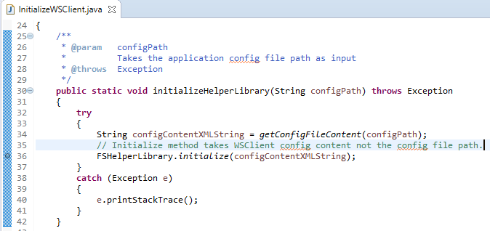
Initialize
initialize()
  Initialize the Library by passing the config.xml as string

Slide 36
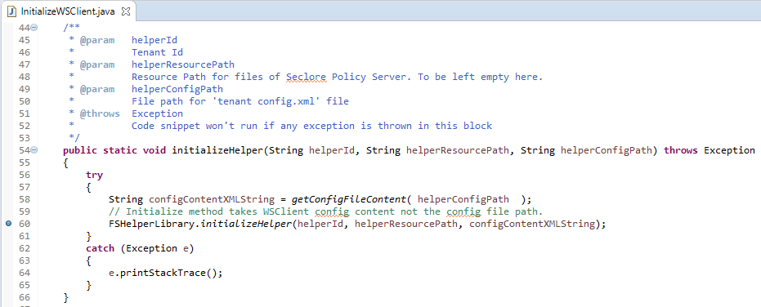
Initialize
initializeHelper()
  This method acts as the single point of entry for the connection to the Policy Server. It creates an API object which can be further utilized to protect/unprotect a file.
  To initialize, pass a unique Identifier for the FSHelper Object, Resource path (this is the path where the buffer files are located), Policy Server connection parameters in xml format from tenant config.xml

Slide 37
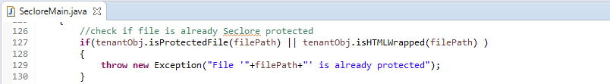
Precheck I
isProtected()
  This method returns whether a file is already protected or not. It takes file path as input parameter.
isHtmlWraped()
  This method checks whether the given file is already HTML wrapped or not.

Slide 38
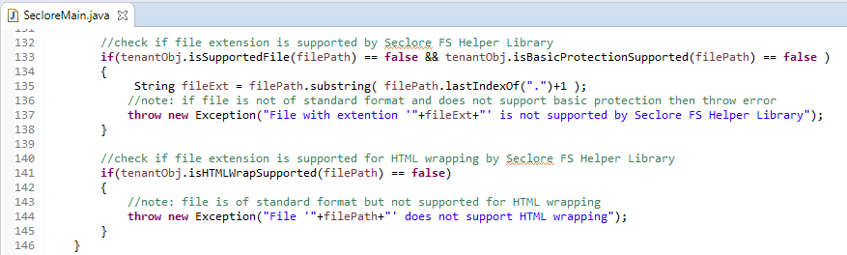
Precheck II
isSupportedFile()
    This method returns whether a file is supported for advanced protection or not. It takes file path as input parameter.
isBasicProtectionSupported()
    This method returns whether a file is supported for universal protection or not. It takes file path as input parameter.
isHtmlWrapSupported()
    This method returns whether a file is supported for HTML Wrapping or not. It takes file path as input parameter.

Slide 39
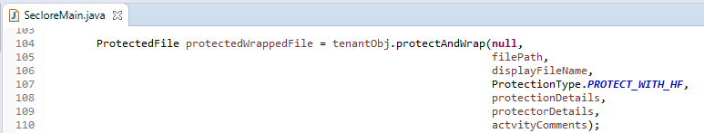
Protect and Wrap
protectAndWrap()
    Call this method to protect and wrap a supported file. This method protects files both supported for advanced protection and universal protection. Depending on the file extension, appropriate protection will be applied.

Slide 40
Protect and Wrap Inputs
protectAndWrap() mandatory parameters
    psConnection – PSConnection received from createPSConnection or getPSConnection. This is an optional parameter. In case it is NULL, this API picks up a session from the session pool. You can pass null for the sample code.
    filePath – This string will contain the path of the file which is to be protected. Pass complete path to file including extension.
    displayFilePath – Pass same as filePath. It is used for logging.
    protectionType – This is type of protection from ProtectionType. Pass ProtectionType.PROTECT_WITH_HF
    protectXML – This string will contain protection details based on the ProtectionType passed above. It should be in XML format. In this sample code, the protection XML is formed by taking the HF ID as an input. You can form the protectXML by passing only the mandatory details. See next slide for details.

Slide 41
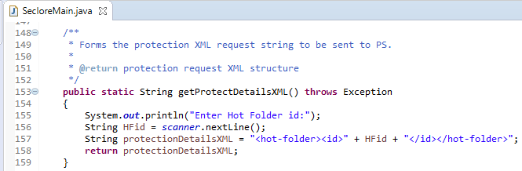
Protect xml- Reference from Sample Code
    Reference from Sample Code
    XML Structure:
<hot-folder>
  <!-- Unique identifier of the Hot Folder. -->
  <id/>
</hot-folder>

Slide 42
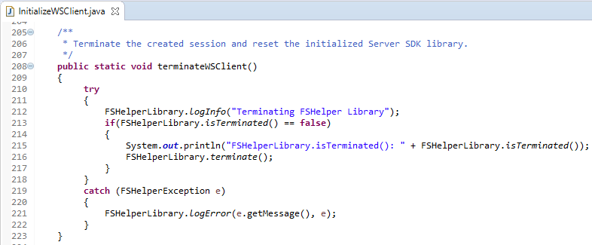
Terminate
terminateHelper()
  This method removes the FSHelper session associated with the current identifier. Pass the same unique Identifier for the FSHelper Object which was passed during initialization.
terminate()
  This method should be called as part of the termination process of the calling application. This method should be called when the application no longer wants to use the library. Please note that the library methods cannot be used once terminate() is called unless initialize() is called again.

Slide 43
Troubleshooting
# | Error Message in WS Log/Console | Steps to correct it
1 | Failed to open output stream | Policy Server not reachable. This could be due to incorrect configuration in “tenant config.xml” or SSL certificate error. Verify Policy Server details in config file. Import SSL certificate in the JRE folder.
2 | Cannot open file in write mode | File is read only or open. Allow write permissions on the file. Close the file if open.
3 | Unable to Decrypt file contents | Unlimited Strength JCE files to be placed in JRE folder
4 | Failed to authenticate the session. | Check if the Enterprise Application ID configured in the “tenant config.xml” exists in Policy Server. Ensure correct passphrase is configured.
5 | The Hot Folder with id ‘xxxx' does not exist | Hot Folder ID entered while running the sample code is not correct
6 | File is already protected | The file you are trying to protect is already protected. Please create another file.
7 | File is not supported for HTML wrapping! | The file you are trying to protect and wrap is not supported. Use a file with supported extension.
8 | Basic protect feature is not enabled in your policy server | Universal protection must be enabled in the Policy Server to protect and wrap non-standard file formats.
9 | Content is not allowed in prolog. *** Config file should be in UTF-16LE encoding *** | Ensure that the config.xml and tenant config.xml files are UTF-8 encoded.
In case of any other issue, send the console output to your Seclore contact.

Slide 44
Summary
Meet all Pre-requisites
Setup environment variable and replace JCE files
Configure config.xml and tenant config.xml file
Run Sample Code
Verify protected and wrapped file

Slide 45
Thank you!

