Slide 1
Sample Code Guide - Protect & Wrap with Independent Rights
How to run the Sample Java Code with Seclore PoC Policy Server

Slide 2
SAMPLE CODE Summary and Purpose
This Sample Code will help you understand the protection and html wrapping flow using Seclore Java SDK
The protection type used in this sample code will allow you to define permission for an user or group during the protection. This protection type is known as Protect with Independent Rights.
You are expected to know the basic concepts of Seclore such as
  Policy Server
  Lite Online Editor
  File Owner
  IRM Permissions
  Seclore Agent
  HTML Wrapping

Slide 3
Sample Code Package
To start with the Sample Code, unzip the delivered package. Package will contain the following and this slide deck.
  Sample Code
  Java SDK
  Code walkthrough video
This slide deck contains steps to run the Sample Code

Slide 4
LIST OF Content
Seclore Concepts and Component Details
Prerequisites
Running the Sample Code
Verify Sample Code Output
Code Blocks

Slide 5
Seclore Component Details

Slide 6

Seclore components

Slide 7
Primary Components
Policy Server
  Central repository of all access keys, usage rights and file activity details.
  Central repository of all user activity / audit logs.
  Computes and serves effective rights for users.
  Standard J2EE application.
  Runs on Windows Server.
  Communicates to Desktop Agent/Mobile App/Web Services using HTTPS connection.
  Encrypts critical info on top of HTTPS to avoid man-in-the-middle attacks.
Seclore Agents
  Available for Windows, Mac, iOS, Android and online file access.
  Required for opening protected files.
  Communicate to Policy Server in the background.
  Control and track all user activities.
  Support all major versions of respective Operating Systems.

Slide 8
Primary Components
Database
  Stores encryption keys, user permissions and user activity details etc.
  MSSQL and Oracle are supported.
  Can run on any Operating System.
  Repository Adaptor (Standard / Custom Authentication)
  Connects to User Repository / User database.
  Manages user authentication.
  Searching of Users / Groups / User-Group mapping.
  Intelligent in-memory caching in Policy Server to ensure minimal load on existing infrastructure.
  Single Sign-on (domain authentication) is used if user is already logged in to the domain.
  Available Out-of-the-box for Active Directory, IBM Tivoli and Seclore Identity Manager
  Can be custom built for other repositories
Lite Online Server
  Comprises of Lite Online Viewer and Lite Online Editor
  Agentless access to protected files
  Documents rendered with watermark
  Runs on windows server
  Lite Online Editor provides editing capabilities for Office documents
  Protected file is uploaded to the Lite Online server through the Policy Server

Slide 9
Server SDK
Server SDKs
 | .NET | JAVA
Build Platform | .NET Framework 3.5 | JDK 8
Platform Support | Integrating application to be .NET 3.5 & above | Integrating application to be JDK 8 & above
OS Support | Windows | Windows, Linux
Compliance | Uses FIPS compliant Algorithm | Uses FIPS compliant Algorithm

Slide 10
Prerequisites

Slide 11

Prerequisites – To run Sample Code
Seclore PoC Policy Server :
  You should be able to access the Seclore PoC Policy Server (PS) URL from the machine on which you will run the Sample Code
  Please refer Sample Code Configuration Details.xlsx (refer to the sheet Policy Server & Client Download ) for the Policy Server details.
Users in Policy Server
  Users are already created in the Seclore PoC Policy Server
  Please refer Sample Code Configuration Details.xlsx (refer to the sheet User Details)

Slide 12
Seclore Agent
To open the protected file, you need to have Seclore client installed on your machine.
You can download the Seclore Lite Client from the URL provided in Sample Code Configuration Details.xlsx (refer sheet Policy Server & Client Download)

Slide 13
Java Cryptographic Encryption Files
Seclore uses strong encryption that is not supported by default Java package so you will need to replace the JCE files (depending on your version of Java) that support unlimited strength.
The unlimited strength JCE files are available in the package shared with you in the following folder:
  \Sample Code\Docs\JCE Files
The folder will have two jars, local_policy.jar and US_export_policy.jar
Place it in the <JRE_FOLDER>/lib/security/ directory of the machine where will be running the Sample Code.
Take backup of old JARs before replacing.

Slide 14


Replace in <JRE_FOLDER>/lib/security
1
JRE/Lib/Security
2
JDK/JRE/Lib/Security

Slide 15
Running the Sample Code

Slide 16


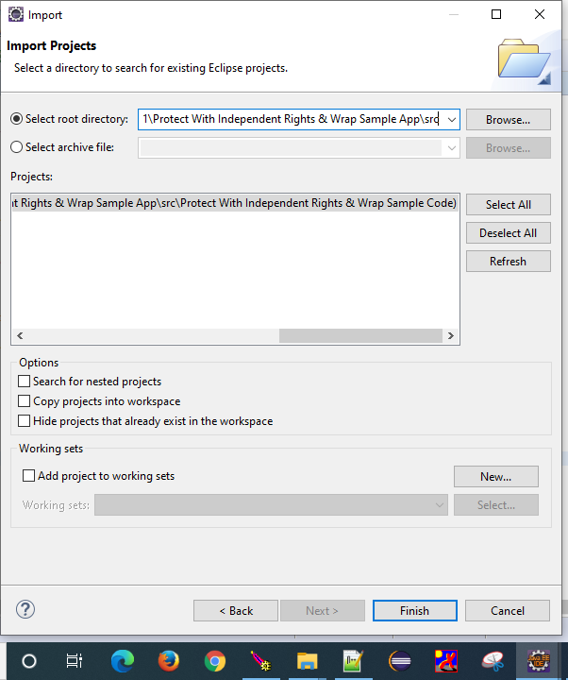
Import the project into an existing workspace in Eclipse
Import the ‘Protect with Independent Rights and Wrap ’ project into an existing workspace in Eclipse

Slide 17
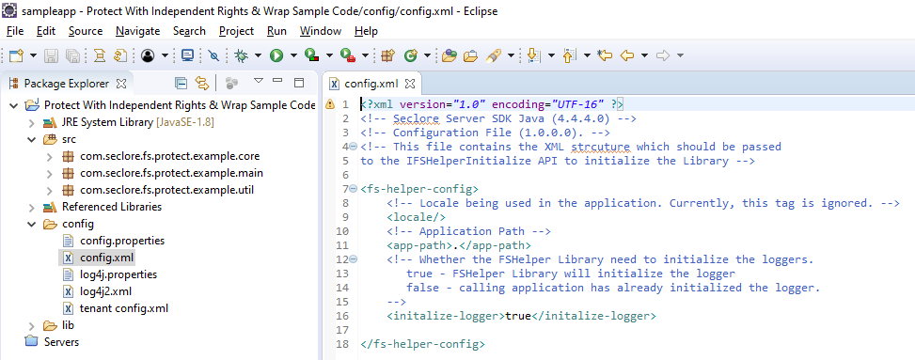
Configuration: config.xml
Configure the ‘config.xml ‘ as explained below:
<app-path> : Provide path of the Source folder.
<initialize-logger> : Set to true

Slide 18
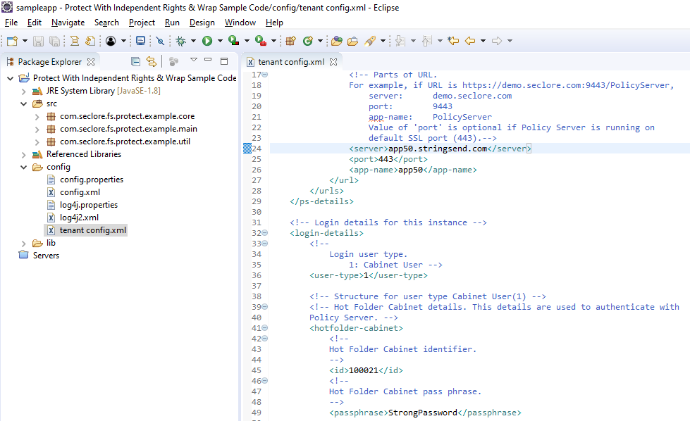
Configuration : tenant config.xml
Configure the ‘tenant config.xml ‘ as explained below (Refer the “Sample Code Configuration Details.xlsx” file for input values)
Enter details of the Seclore Policy Server:
<server>: Server Name
<port>: Port
<app-name> : Application name
Enter login details:
<user-type> : Set to 1

Slide 19
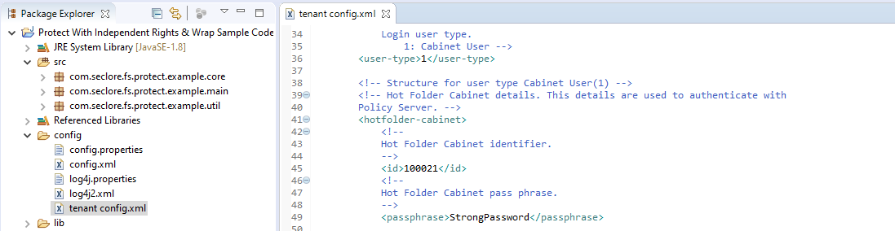
Configuration : tenant config.xml
Configure the ‘tenant config.xml ‘ as explained below (Refer the “Sample Code Configuration Details.xlsx” file for input values)
Enter details of Enterprise Application created in Policy Server:
id: Enterprise Application ID in Policy Server
passphrase: Passphrase of the EA

Slide 20
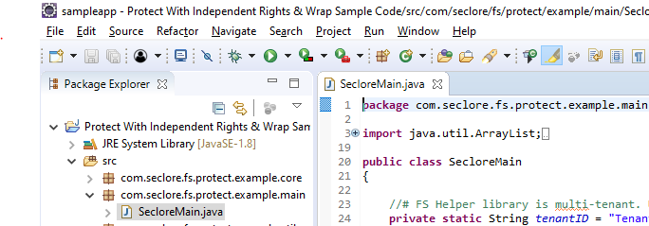
Executing Sample Code
Execute the sample code

Slide 21
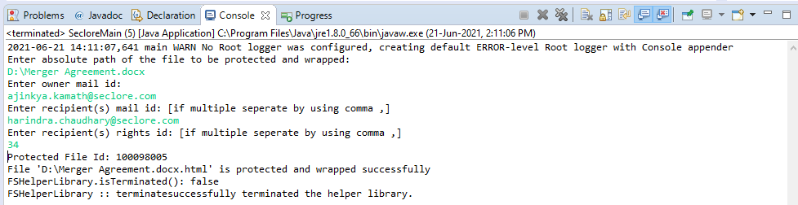
Executing Sample Code – Protection + HTML Wrap
Execute the sample code : Console Output
Enter the absolute path of the file you want to protect.
Enter the owner email address. Refer the “Sample Code Configuration Details.xlsx” file for user details (refer sheet User Details)
Enter the recipient email addresses (comma separated). Refer the “Sample Code Configuration Details.xlsx” file for user details (refer sheet User Details)
Enter the permission ID for the recipient. To calculate the permission ID refer to “FSRighstsCalculator.html” provided in the package.
On successful protection the sample code will display the Protected File ID.
Enter the file path of the protected file to HTML Wrap the file.
On successful wrapping, a new file with .html extension will be created in the same location.

Slide 22
Verify Sample Code Output

Slide 23
Verify File is Protected and HTML Wrapped
Compare File Size
  After file gets protected, the file size increases by 64 kb. This is due to the encryption layer around the file.
  So if you protected “Test Protection.txt”, after running the sample code, you should see the original file size increased by 64 kb.
Verify File Extension
  HTML Wrapping of the protected file will create a new file with “.html” extension. So if you protected and wrapped “Test Protection.txt”, after running the sample code, you should see a new file called “Test protection.txt.html” in the same location.

Slide 24
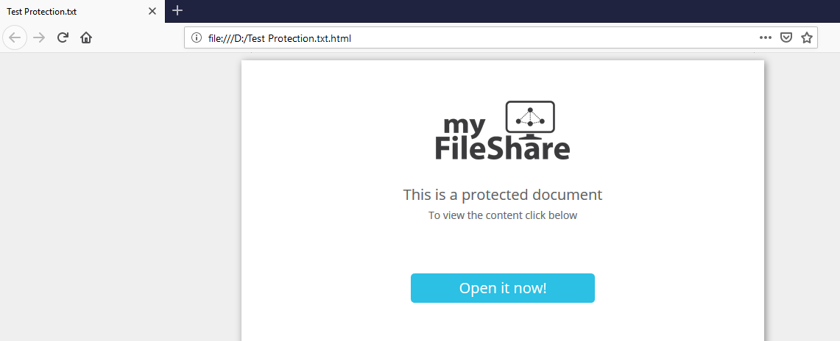
Opening the HTML Wrapped File – Authorized Access
Open the HTML Wrapped File without installing the agent.
File will be launched in the browser.
Click ‘Open it now!’ to view the file in the Seclore Online Editor.
Login using authorized username and password. Refer the “Sample Code Configuration Details.xlsx” file for the login details.

Slide 25
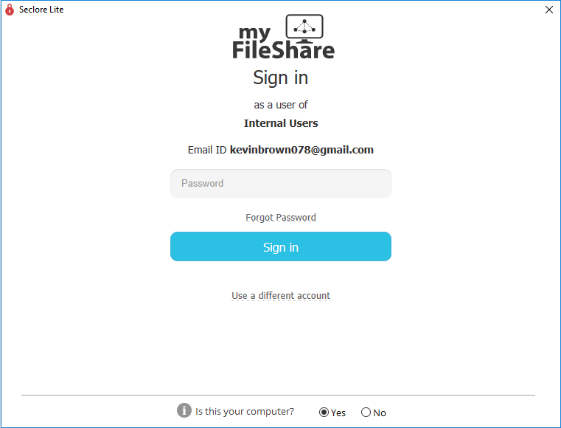
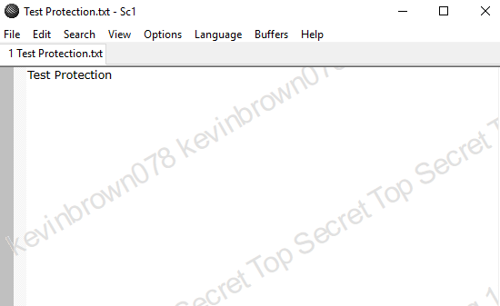
Opening the Protected File – Authorized Access
Install the Seclore Client
Open the protected file.
File will open for authorized users based on user permission defined in the policy server.
Login using authorized username and password. Refer the “Sample Code Configuration Details.xlsx” file for the login details.
Protected File Opens

Slide 26
Code Blocks

Slide 27
Protection Approach
Initialize FS Helper Library using Initialize() and InitializeHelper()
  Include all supporting DLLs or Jars
  Configure the Logger
  Configure the Seclore Policy Server details
Get inputs for File Protection
  Complete File Path
  File Owner
  Recipients of the file
  Permissions of each recipient on the file (use FSRightsCalculator.HTML as reference to calculate the Seclore rights)
Check if the file is already Protected using isProtected() and isHTMLWrapped()
Check if the file is unsupported using isSupportedFile() , isBasicProtectionSupported() & isHTMLWrapSupported()
Create the protectXML -- (which will be an input to the protectAndWrap() method
  Determine the Seclore Classification ID - use default as 1
  For every recipient,
    Determine the unique user id -- use getUserDetails Request to fetch information from Seclore Policy Server
    Determine the Primary Access rights (using the reference as FSRightsCalculator.HTML)
    Determine if the user needs to be provided Offline permissions and Redistribute permissions
    Build the ProtectXML with the above information
  For the file owner
    Determine the unique user id -- use getUserDetails Request to fetch information from Seclore Policy Server
Protect & wrap the file with protectAndWrap() method, by passing all the required parameters, including protectXML. Successful Protection returns a FileID
Terminate() the Libraries

Slide 28
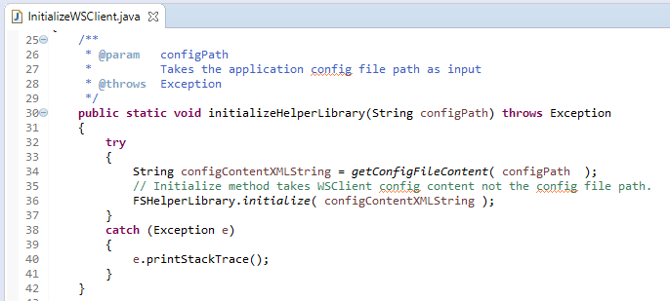
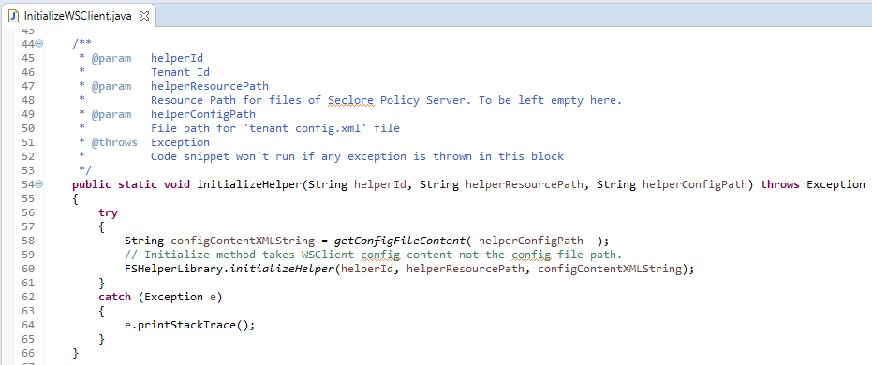
Initialize
Initialize()
  Initialize the Library by passing the config.xml as string
  Refer to InitializeWSClient.java in the sample code.
InitializeHelper()
  This method acts as the single point of entry for the connection to the Policy Server. It creates an API object which can be further utilized to protect/unprotect a file.
  To initialize, pass a unique Identifier for the FSHelper Object, Resource path (this is the path where the buffer files are located), Policy Server connection parameters in xml format from tenant config.xml

Slide 29
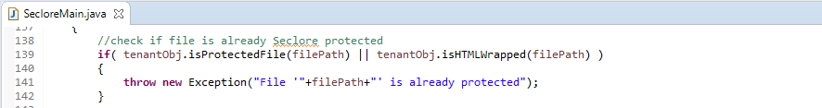
Precheck I
isProtected()
  This method returns whether a file is already protected or not. It takes file path as input parameter.
isHtmlWraped()
  This method checks whether the given file is already HTML wrapped or not.

Slide 30
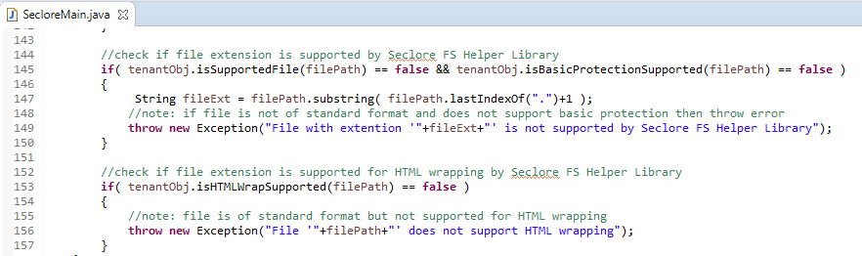
Precheck II
isSupportedFile()
    This method returns whether a file is supported for advanced protection or not. It takes file path as input parameter.
isBasicProtectionSupported()
    This method returns whether a file is supported for universal protection or not. It takes file path as input parameter.
isHtmlWrapSupported()
    This method returns whether a file is supported for HTML Wrapping or not. It takes file path as input parameter.

Slide 31
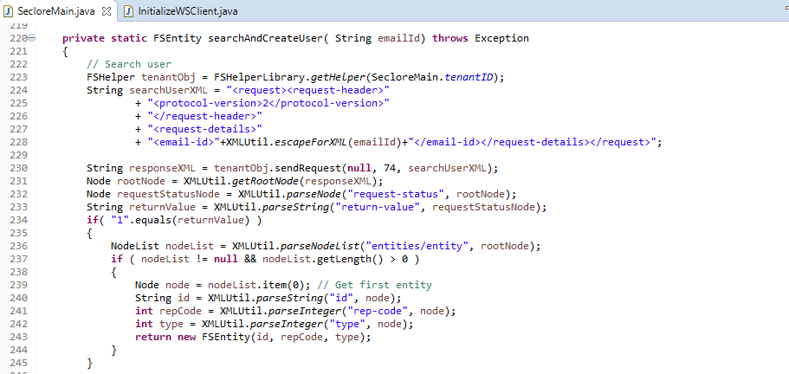
SEARCH USER
Send a request to Policy Server to get the User Details
Request XML structure provided below:
<request>
<request-header>
<protocol-version>2</protocol-version>
</request-header>
<request-details>
<email-id>[END-USER-EMAIL-ID]</email-id>
</request-details>
</request>
Policy Server will respond with the following User Details
  Type
  rep-code
  id
Use these values while forming the ProtectXML in next steps.

Slide 32
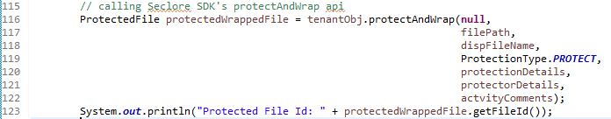
Protect and Wrap
protectAndWrap()
    Call this method to protect and wrap a supported file. This method protects files both supported for advanced protection and universal protection. Depending on the file extension, appropriate protection will be applied.

Slide 33
Protect and Wrap Inputs
protectAndWrap() mandatory parameters
    psConnection – PSConnection received from createPSConnection or getPSConnection. This is an optional parameter. In case it is NULL, this API picks up a session from the session pool. You can pass null for the sample code.
    filePath – This string will contain the path of the file which is to be protected. Pass complete path to file including extension.
    displayFilePath – Pass same as filePath. It is used for logging.
    protectionType – This is type of protection from ProtectionType. Pass ProtectionType.PROTECT
    protectXML – This string will contain protection details based on the ProtectionType passed above. It should be in XML format. In this sample code, the protection XML is formed by taking user input. You can form the protectXML by passing only the mandatory details. See next slide for details.

Slide 34
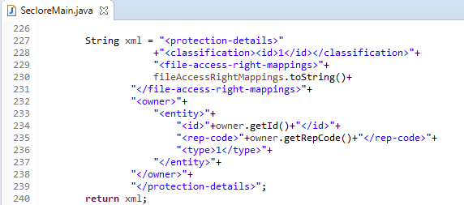
Protect xml- Reference from Sample Code
    Reference from Sample Code

Slide 35
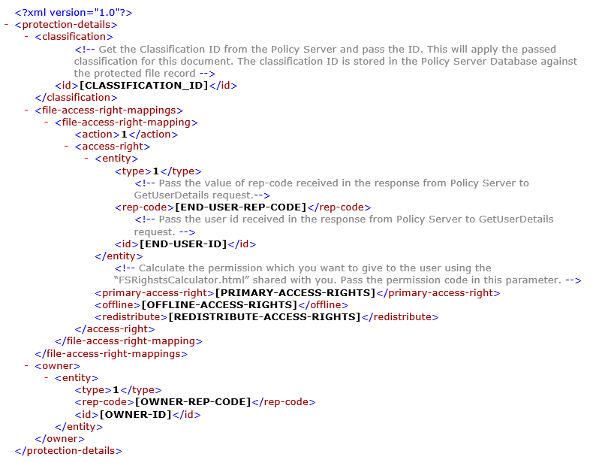
Protect xml
protectXML – Form the xml as below. Refer to the comments inline.

Slide 36
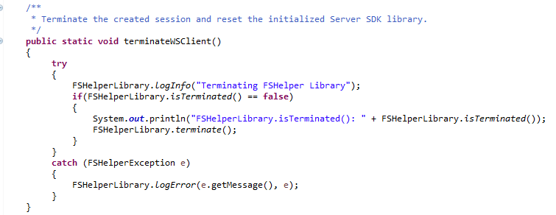
Terminate
TerminateHelper()
  This method removes the FSHelper session associated with the current identifier. Pass the same unique Identifier for the FSHelper Object which was passed during initialization.
Terminate()
  This method should be called as part of the termination process of the calling application. This method should be called when the application no longer wants to use the library. Please note that the library methods cannot be used once terminate() is called unless initialize() is called again.

Slide 37
Troubleshooting
# | Error Message in WS Log | Steps to correct it
1 | PS not reachable | SSL Certificate error. Import SSL certificate in the JRE folder
2 | Unable to edit the file | File is read only. Allow write permissions on the file
3 | Unable to Decrypt file contents | Unlimited Strength JCE files to be placed in JRE folder
4 | Failed to authenticate the session | Rep-code or user details configured in the tenant config.xml is incorrect
5 | File with extension 'abc' is not supported by Seclore FS Helper Library | The file you are trying to protect is not supported by Seclore. Please use a text or office file format for testing.
6 | File with extension 'abc' is not supported by Seclore FS Helper Library | The file you are trying to protect is not supported by Seclore. Please use a text or office file format for testing.
7 | File is already protected | The file you are trying to protect is already protected. Please create another file.
8 | File is not supported for HTML wrapping! | The file you are trying to protect and wrap is not supported. Use a file with supported extension.
9 | Basic protect feature is not enabled in your policy server | Universal protection must be enabled in the Policy Server to protect and wrap non-standard file formats.
10 | Content is not allowed in prolog. *** Config file should be in UTF-16LE encoding *** | Ensure that the config.xml and tenant config.xml files are UTF-8 encoded.
In case of any other issue, send the console output to support@Seclore.com

Slide 38
Summary
Meet all Pre-requisites
Setup environment variable and replace JCE files
Configure config.xml and tenant config.xml file
Run Sample Code
Verify protected file

Slide 39
Thank you!

