Slide 1
Sample Code Guide – Unwrap and Unprotect in EA Context
How to run the Sample Java Code using Enterprise Policy Server

Slide 2
SAMPLE CODE Summary and Purpose
This Sample Code will help you understand how to unwrap and unprotect a Seclore protected file using the Seclore Java SDK
The unprotection happens in the Enterprise Application context. i.e. the SDK has to be initialized with the same EA which was used to protect the file.
You are expected to know the basic concepts of Seclore such as
  Policy Server
  Enterprise Application (EA)
  Hot Folder (HF)
  HTML Wrapping

Slide 3
Sample Code Package
To start with the Sample Code, unzip the delivered package. Package will contain the following and this slide deck.
  Sample Code
  Java SDK
  Code walkthrough video
This slide deck contains steps to run the Sample Code

Slide 4
LIST OF Content
Seclore Concepts and Component Details
Prerequisites
Running the Sample Code
Verify Sample Code Output
Code Blocks

Slide 5
Seclore Concepts & Component Details

Slide 6

Seclore components

Slide 7
Primary Components
Policy Server
  Central repository of all access keys, usage rights and file activity details.
  Central repository of all user activity / audit logs.
  Computes and serves effective rights for users.
  Standard J2EE application.
  Runs on Windows Server.
  Communicates to Desktop Agent/Mobile App/Web Services using HTTPS connection.
  Encrypts critical info on top of HTTPS to avoid man-in-the-middle attacks.
Seclore Agents
  Available for Windows, Mac, iOS, Android and online file access.
  Required for opening protected files.
  Communicate to Policy Server in the background.
  Control and track all user activities.
  Support all major versions of respective Operating Systems.

Slide 8
Primary Components
Database
  Stores encryption keys, user permissions and user activity details etc.
  MSSQL and Oracle are supported.
  Can run on any Operating System.
  Repository Adaptor (Standard / Custom Authentication)
  Connects to User Repository / User database.
  Manages user authentication.
  Searching of Users / Groups / User-Group mapping.
  Intelligent in-memory caching in Policy Server to ensure minimal load on existing infrastructure.
  Single Sign-on (domain authentication) is used if user is already logged in to the domain.
  Available Out-of-the-box for Active Directory, IBM Tivoli and Seclore Identity Manager
  Can be custom built for other repositories
Lite Online Server
  Comprises of Lite Online Viewer and Lite Online Editor
  Agentless access to protected files
  Documents rendered with watermark
  Runs on windows server
  Lite Online Editor provides editing capabilities for Office documents
  Protected file is uploaded to the Lite Online server through the Policy Server

Slide 9
Server SDK
 | .NET | JAVA
Build Platform | .NET Framework 3.5 | JDK 8
Platform Support | Integrating application to be .NET 3.5 & above | Integrating application to be JDK 8 & above
OS Support | Windows | Windows, Linux
Compliance | Uses FIPS compliant Algorithm | Uses FIPS compliant Algorithm

Slide 10
Seclore Concepts
Enterprise Application
  Enterprise Application (EA) is the construct on Seclore Policy Server created to facilitate integration with Applications. An EA was a way for an Application to connect to Seclore through Seclore APIs. Each EA created has a Unique ID and can be mapped to one integrating application. Seclore APIs are initialized by referring to the Seclore Policy Server URL and the EA
  The integrating application will use the EA ID and Passphrase (configured at the time of EA creation) for authenticating the Seclore API with Policy Server. This authenticated session will be used by the Seclore API to perform any subsequent actions like protect, upload file to Lite Online etc.
  The EA instance also allows you to configure a web service URL which is used by the Policy Server during Policy Federation.
Hot Folder
  HotFolder is a construct available within an EA. It is a combination of a Default File Owner, a default Classification on the protected files.
  Each HotFolder has a Unique ID and One EA can have one or more Hot Folders. Based on a Business logic requirement, a HotFolder may be mapped to the Integrating Application’s Document Library/Director or even a Project.
  At the time of Protection, the Seclore API expects a HotFolder ID to be passed as a parameter.

Slide 11
Prerequisites

Slide 12
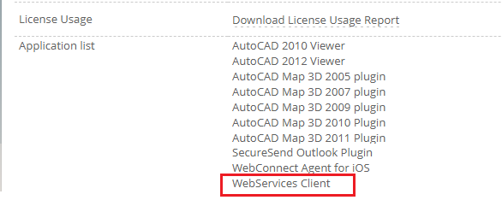

Servers and API license
Policy Server and Lite Online Editor
  Identify the PolicyServer(PS) deployed/used by your organization on which this exercise is to be carried out.
    Check with your IT security team or contact your Seclore Point of Contact for this
  This is usually done on a UAT/Test PS , but can also be done in the production PS
  Check if the Seclore Policy Server is accessible. Note the URL.
API License
  Your organization will require an API license to use Seclore APIs for Integration.
  You can check this yourself if you have access to the Policy Server as root/sysadmin user. Below are the steps to follow to check this out
    As Root/Sysadmin:
    Login to PS using the sysadmin URL
    Click on ‘License’ tab
    Check if ‘WebServices Client’
    exists under Application List

Slide 13
Seclore Protected File
You will need a HTML Wrapped + Protected file to run the sample code.
You can use the sample code “Protect & Wrap using Hot Folder” to create protected files. Contact your Seclore representative to get the protection sample code.

Slide 14
Java Cryptographic Encryption Files (applicable for Java 8 and above)
Seclore uses strong encryption that is not supported by default Java package so you will need to replace the JCE files (depending on your version of Java) that support unlimited strength.
The unlimited strength JCE files are available in the package shared with you in the following folder:
  \Sample Code\Docs\JCE Files
The folder will have two jars, local_policy.jar and US_export_policy.jar
Place it in the <JRE_FOLDER>/lib/security/ directory of the machine where will be running the Sample Code.
Take backup of old JARs before replacing.

Slide 15


Replace in <JRE_FOLDER>/lib/security
1
JRE/Lib/Security
2
JDK/JRE/Lib/Security

Slide 16
SSL Certificate
If Policy Server is running on self signed certificate, need to import the certificate into JRE which is used for Client Library.
Steps to import the self signed certificate:-
  Access Policy Server in any browser and download the self signed certificate.
  Execute below command from CMD
  <JRE-FOLDER>\bin\keytool.exe -import -alias "<ALIAS-NAME-FOR-CERTIFICATE>" -keystore "<JRE-FOLDER>\lib\security\cacerts" -file "<Downloaded_CERTIFICATE-PATH>“
  Example : keytool -import -alias "ps_cert" -keystore "C:\Program Files\Java\jre7\lib\security\cacerts" -file “XXXXX\filesecure.cer“
If it asks for password, enter 'changeit' , this is default password for jre.

Slide 17
Running the Sample Code

Slide 18


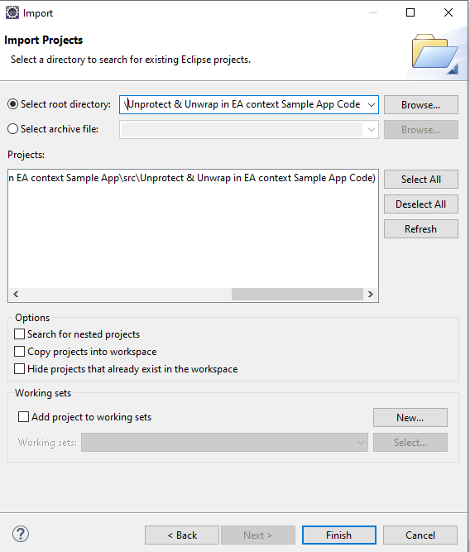
Import the project into an existing workspace in Eclipse
Import the ‘Unprotect & Unwrap in EA context’ project into an existing workspace in Eclipse

Slide 19
Configuration: config.xml
Configure the ‘config.xml ‘ as explained below:
<app-path> : Provide path of the folder where you have the log4j.properties file.
<initialize-logger> : Set to true

Slide 20
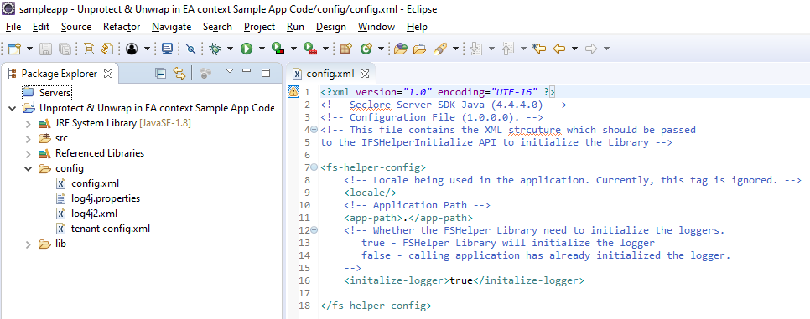
Configuration: config.xml
Configure the ‘config.xml ‘ as explained below:
<app-path> : Provide path of the folder where you have the “config/log4j2.xml” file. For the sample code, this will be the path till the “Source” folder.
<initialize-logger> : Set to true

Slide 21
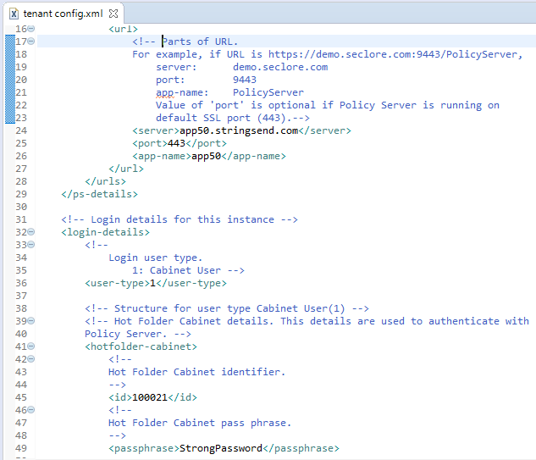
Configuration : tenant config.xml
Configure the ‘tenant config.xml ‘ as explained below
Enter details of the Seclore Policy Server:
<server>: Policy Server
<port>: Port
<app-name>: Application name
Example: If your Policy Server URL is https://app50.stringsend.com/app50
the configuration will look like the config shown in the screenshot
Enter login details:
<user-type> : Set to 1
<id>: Enter the Enterprise Application ID
<passphrase> : Enter the Enterprise Application Passphrase

Slide 22
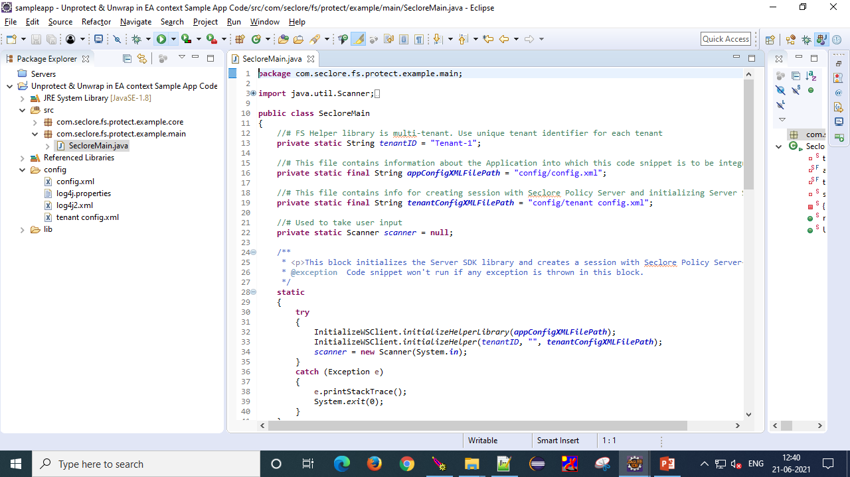
Executing Sample Code
Execute the sample code

Slide 23
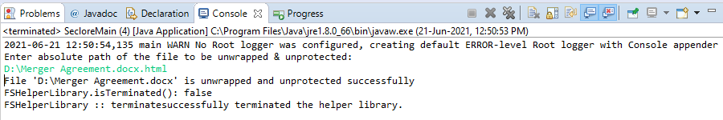
Executing Sample Code – Unwrap + Unprotect
Execute the sample code : Console Output
Enter the absolute path of the HTML Wrapped file you want to Unwrap.
After the file is unwrapped and unprotected, the sample code will display the message. You should be able to see the file without .html extension.

Slide 24
Verify Sample Code Output

Slide 25
Verify File is Unprotected
File Opens Normally
  After file gets unprotected, it should open normally without any prompt for authentication.

Slide 26
Code Blocks

Slide 27
UNProtection Approach
Initialize FS Helper Library using initialize() and initializeHelper()
  Include all supporting DLLs or Jars
  Configure the Logger
  Configure the Seclore Policy Server details
Check if the file is Wrapped or not using isHTMLWrapped()
Unwrap and Unprotect the wrapped + protected file using unwrapAndUnprotect() method.
terminate() the library

Slide 28
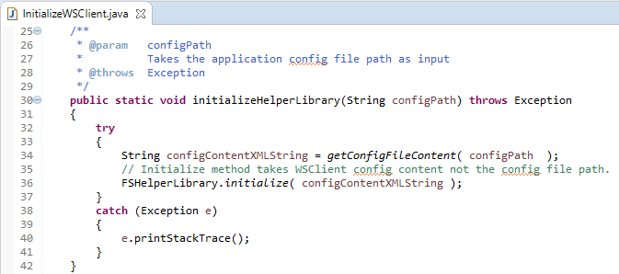
Initialize
initialize()
  Initialize the Library by passing the config.xml as string

Slide 29
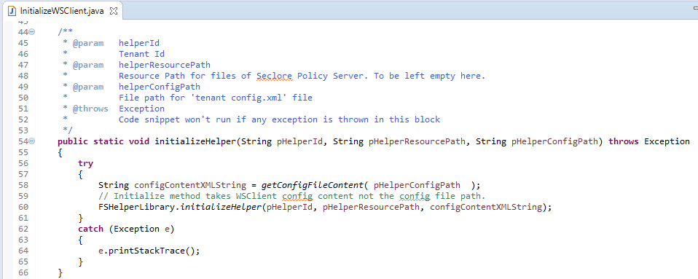
Initialize
initializeHelper()
  This method acts as the single point of entry for the connection to the Policy Server. It creates an API object which can be further utilized to protect/unprotect a file.
  To initialize, pass a unique Identifier for the FSHelper Object, Resource path (this is the path where the buffer files are located), Policy Server connection parameters in xml format from tenant config.xml

Slide 30
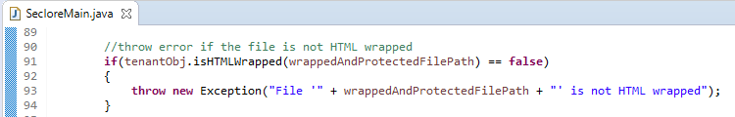
precheck
isHTMLWrapped()
    This method returns whether a file is HTML Wrapped or not. It takes file path as input parameter.

Slide 31
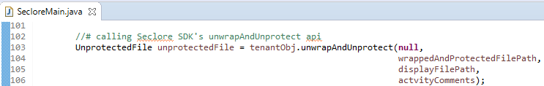
Unwrap and Unprotect
unwrapAndUnprotect()
    This method is used to unwrap and unprotect a file which is protected and wrapped using advanced or universal protection.
    Authenticated PSConnection used to unwrap and unprotect the file should have permission.

Slide 32
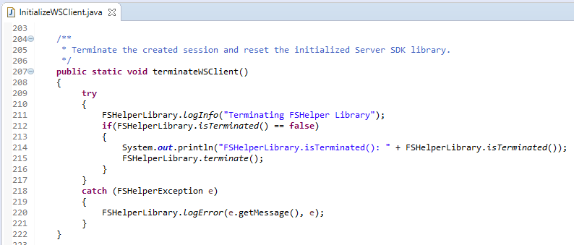
Terminate
Terminate()
  This method should be called as part of the termination process of the calling application. This method should be called when the application no longer wants to use the library. Please note that the library methods cannot be used once terminate() is called unless initialize() is called again.

Slide 33
Troubleshooting
# | Error Message in WS Log | Steps to correct it
1 | Failed to open output stream | Policy Server not reachable. This could be due to incorrect configuration in “tenant config.xml” or SSL certificate error. Verify Policy Server details in config file. Import SSL certificate in the JRE folder.
2 | Cannot open file in write mode | File is read only or open. Allow write permissions on the file. Close the file if open.
3 | Unable to Decrypt file contents | Unlimited Strength JCE files to be placed in JRE folder
4 | Failed to authenticate the session. | Check if the Enterprise Application ID configured in the “tenant config.xml” exists in Policy Server. Ensure correct passphrase is configured.
5 | File is not HTML wrapped! Hence, cannot be unwrapped and unprotected | The file you are trying to unprotected is not HTML Wrapped. Please create another file.
6 | Content is not allowed in prolog. *** Config file should be in UTF-16LE encoding *** | Ensure that the config.xml and tenant config.xml files are UTF-8 encoded.
In case of any other issue, send the console output to your Seclore contact.

Slide 34
Summary
Meet all Pre-requisites
Setup environment variable and replace JCE files
Configure config.xml and tenant config.xml file
Run Sample Code
Verify unprotection

Slide 35
Thank you!

